Slide 1
Freelancing tasks
By: Khalid Salim

Slide 2
AGENDA
Portfolio
Accounts
Submitted Services/Proposals
Contacted Clients (None)
Payment Method
Challenges Faced
How I overcame them

Slide 3
Portfolio Website

Slide 4

Portfolio: Header

Slide 5

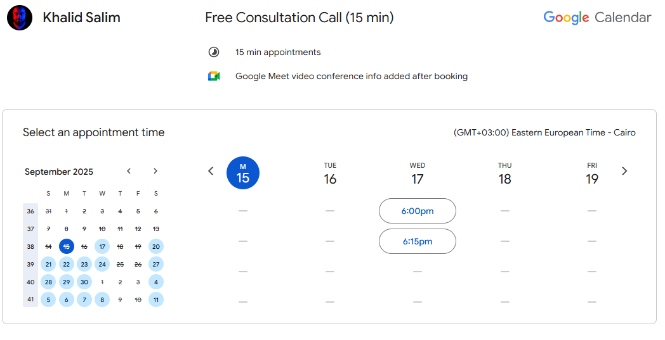

Portfolio: Header Buttons

Slide 6
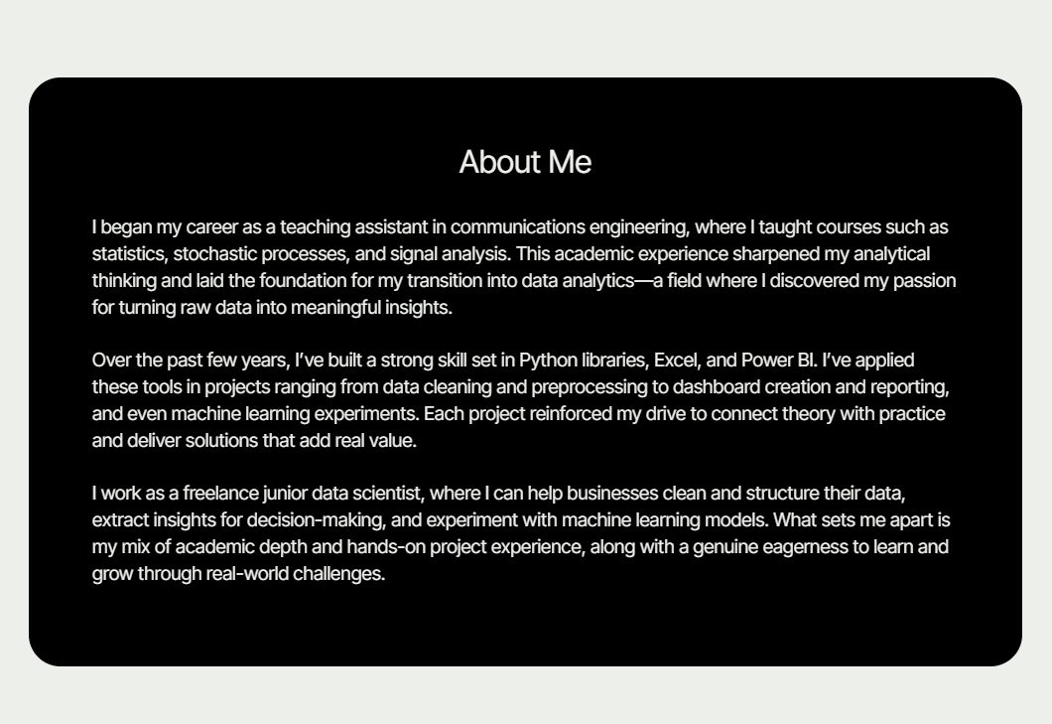
Portfolio: About

Slide 7
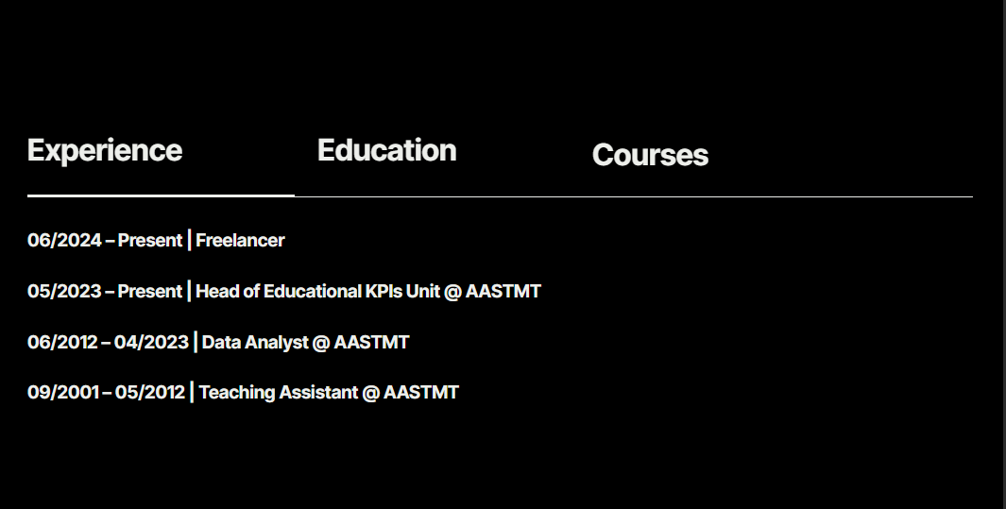
Portfolio: Experience/education/courses

Slide 8
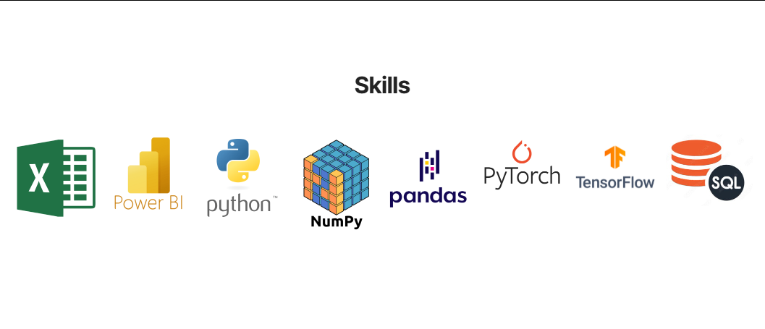
Portfolio: Skills

Slide 9
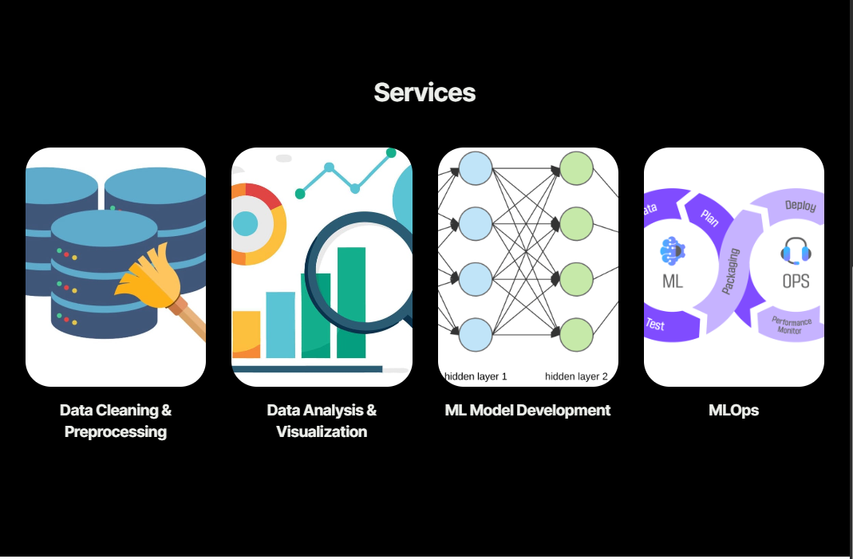
Portfolio: Services

Slide 10
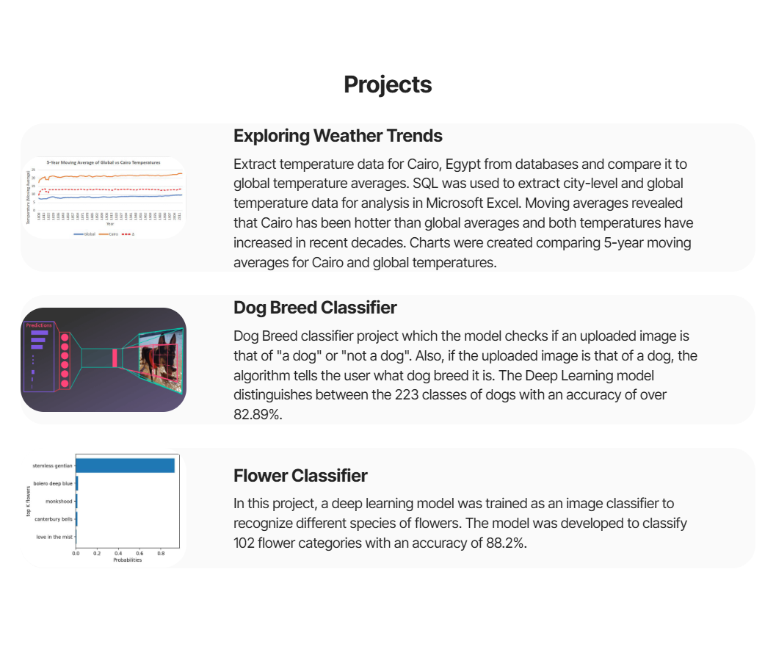
Portfolio: Projects

Slide 11
acounts

Slide 12
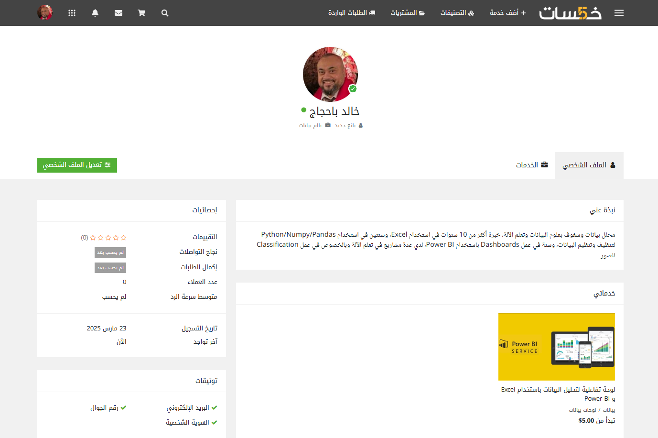
Khamsat

Slide 13
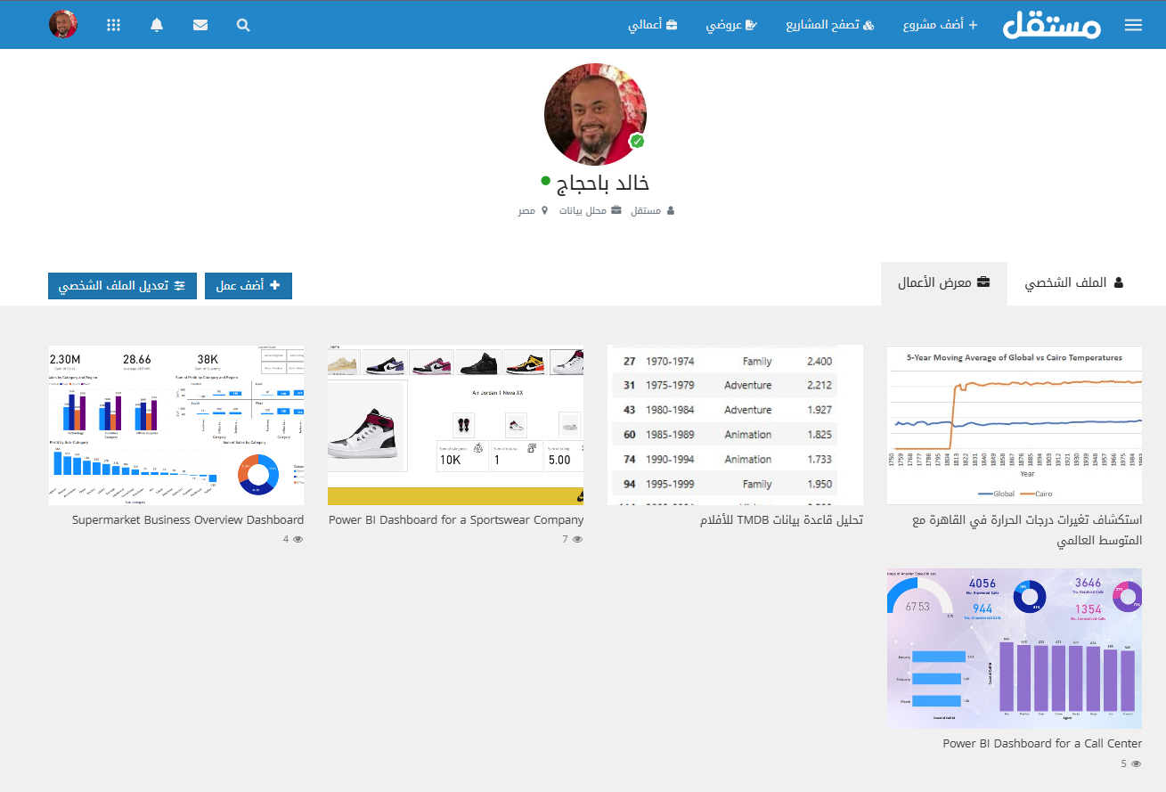
mostaql

Slide 14
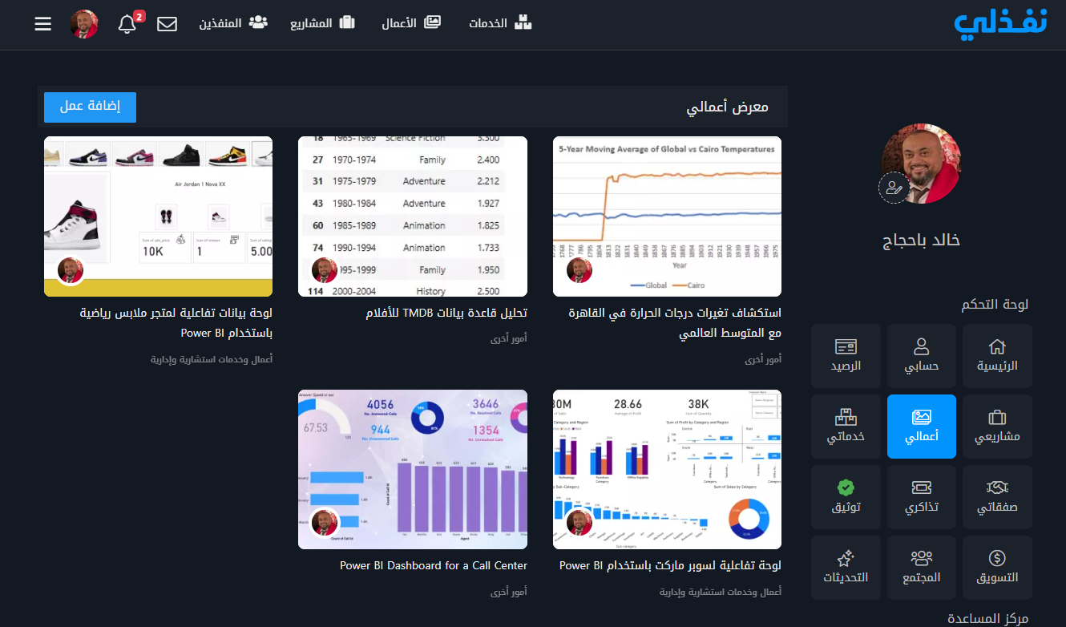
mostaql

Slide 15
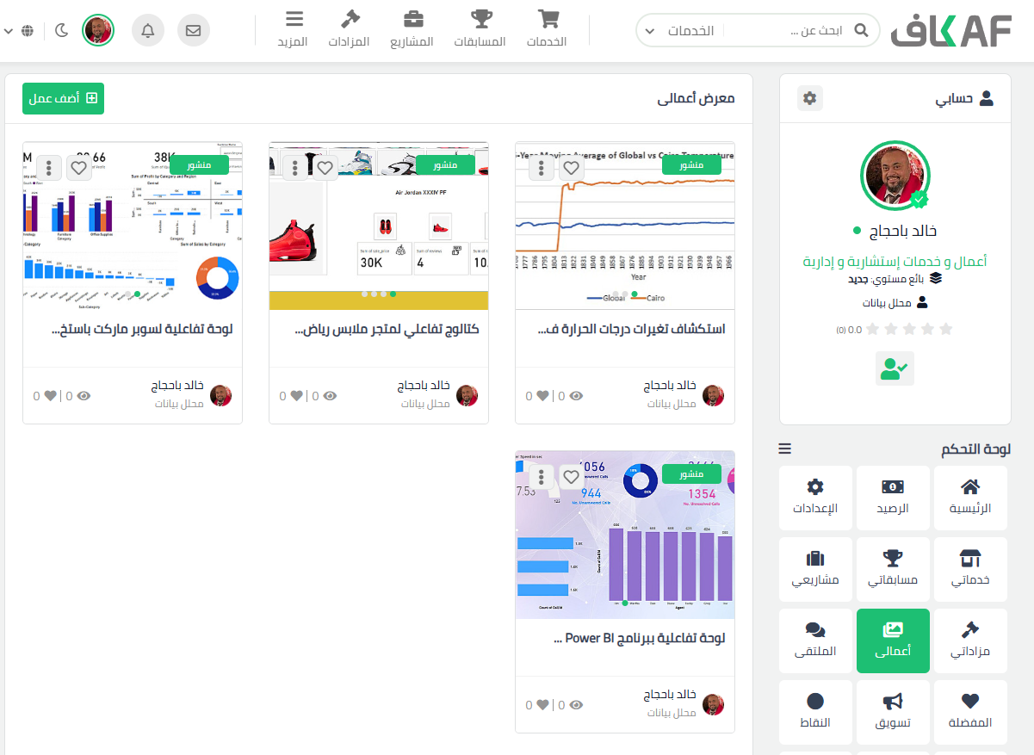
Kafiil

Slide 16
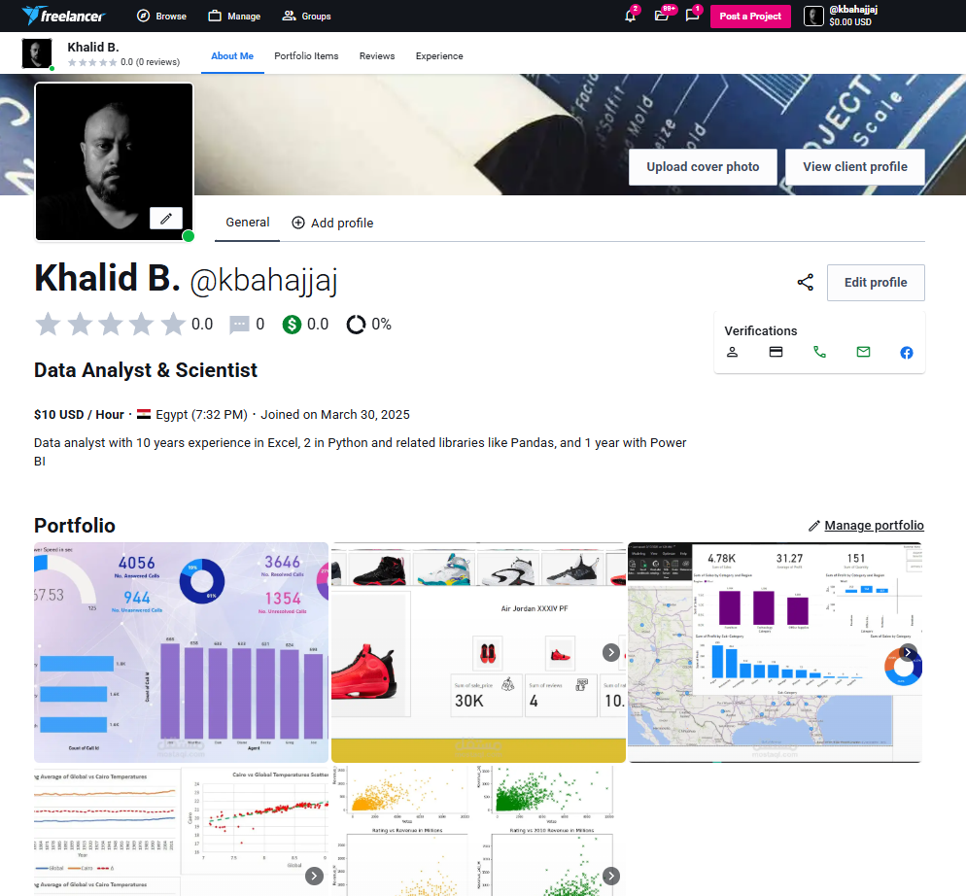
freelancer

Slide 17
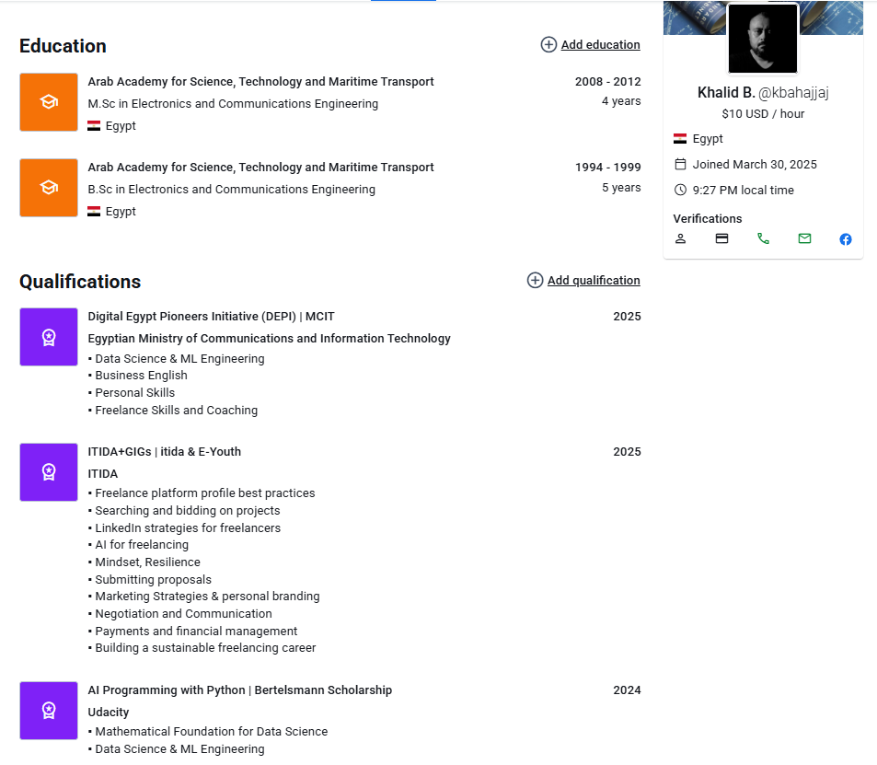
Freelancer (cont.)

Slide 18

Upwork

Slide 19
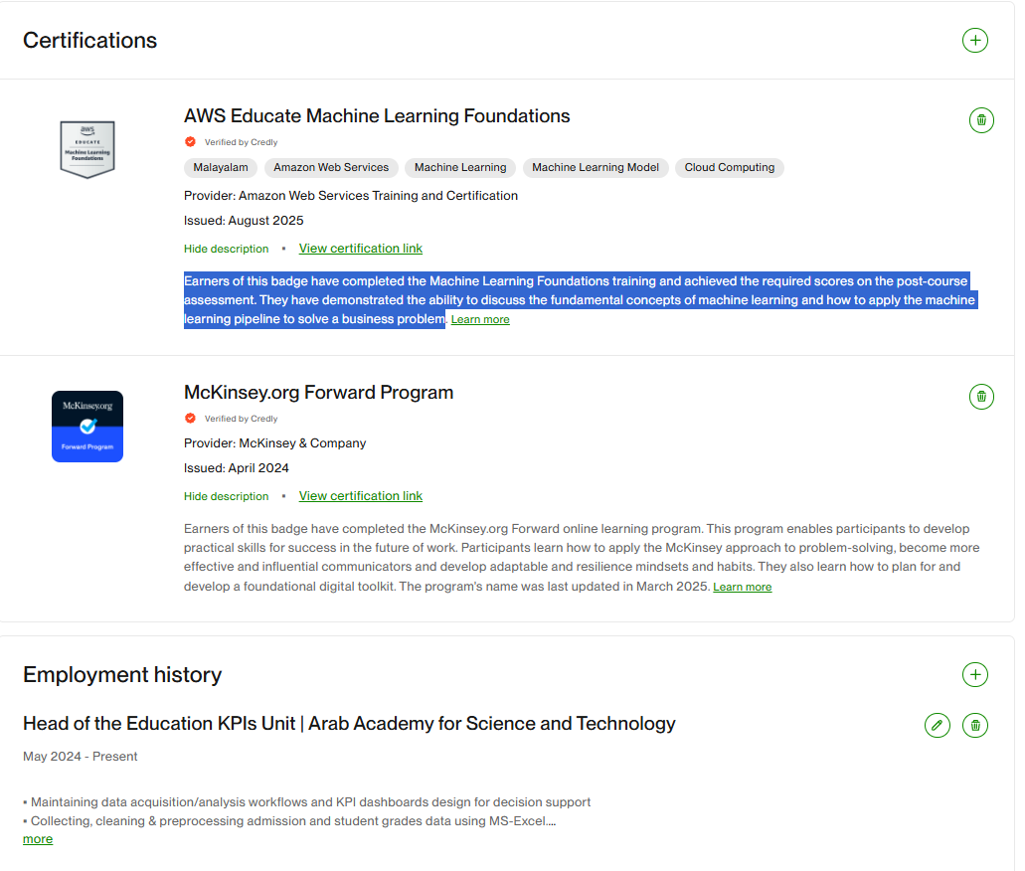
Upwork (cont.)

Slide 20
Submitted Services & Proposals

Slide 21
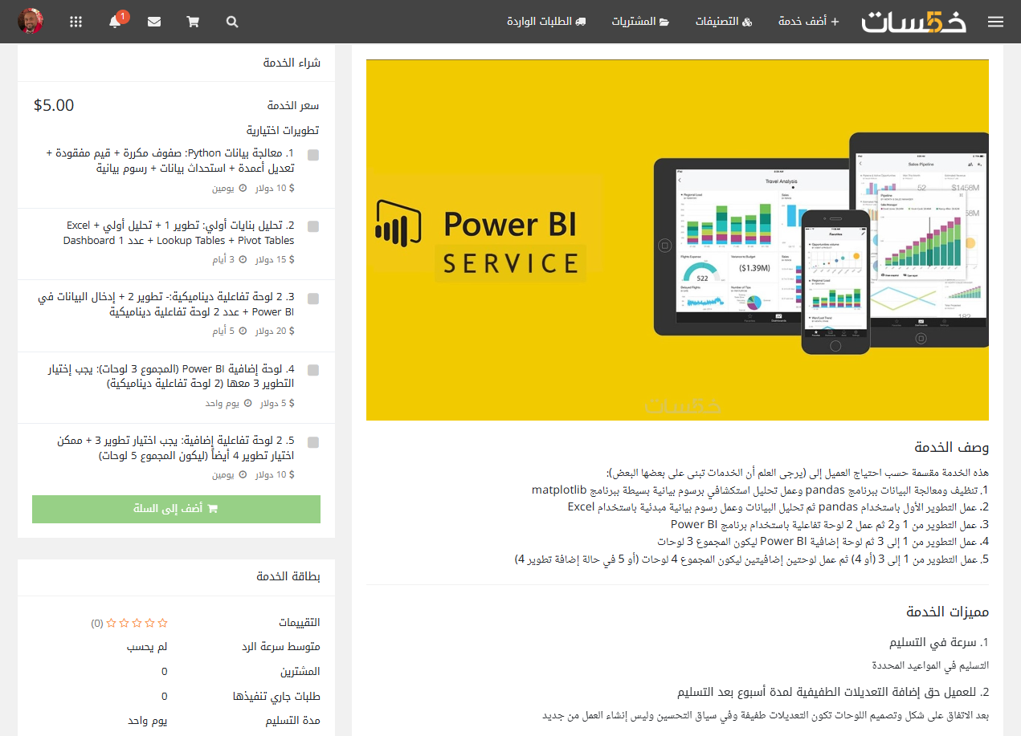
Khamsat Service

Slide 22
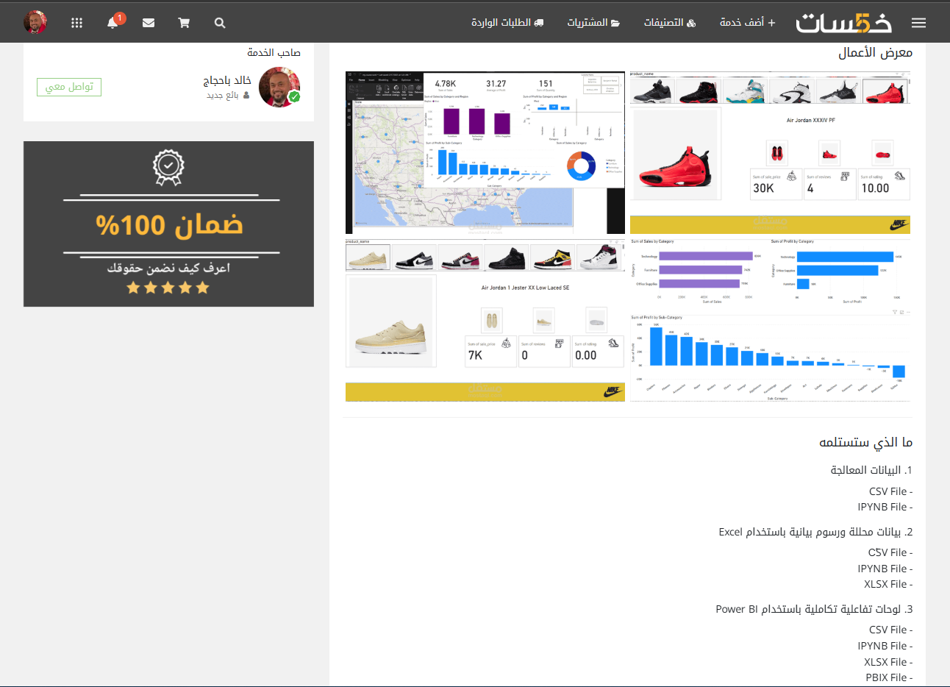
Khamsat Service (Cont.)

Slide 23
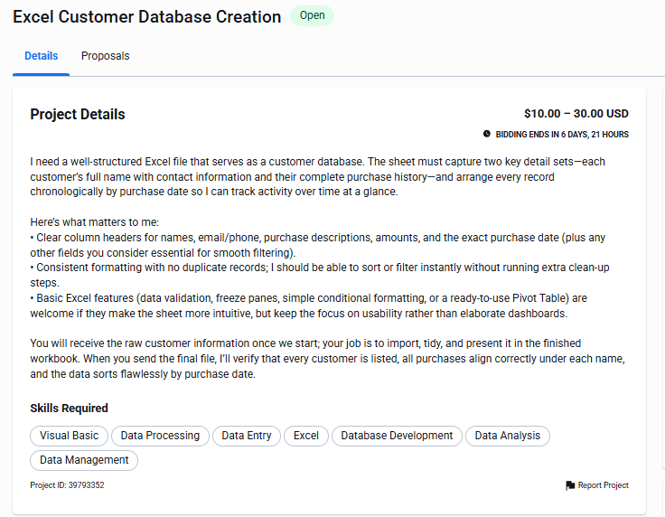
Proposal 1: description

Slide 24
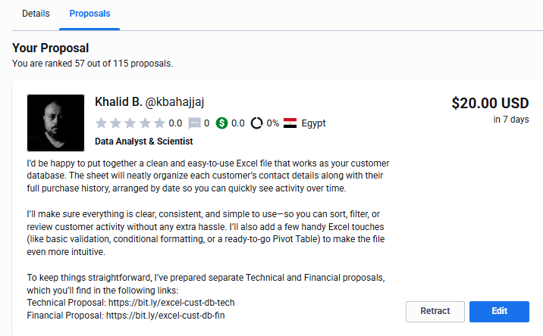
Proposal 1: My Bid

Slide 25
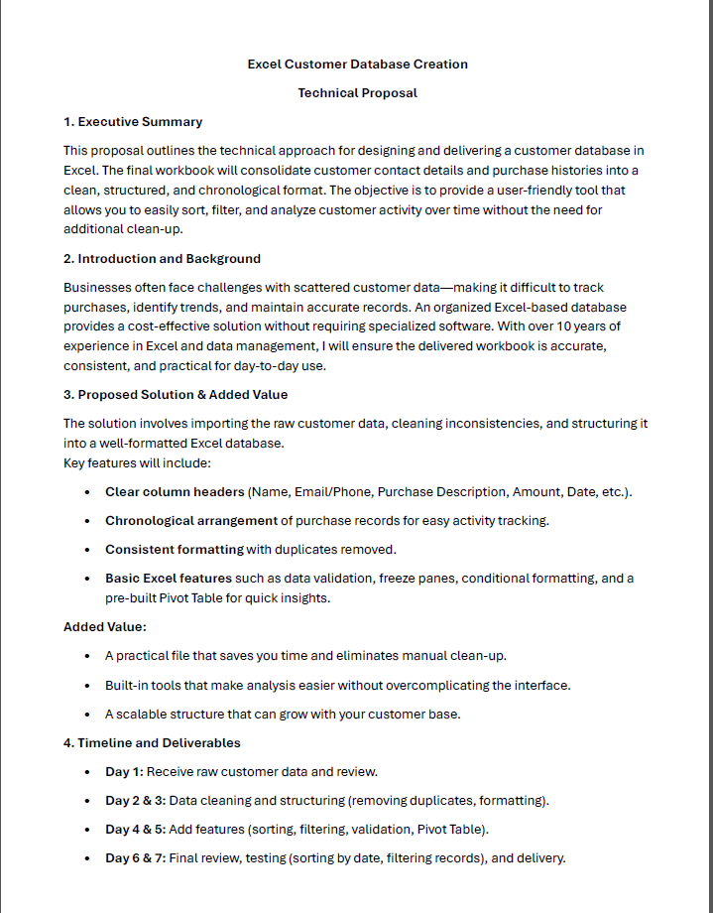
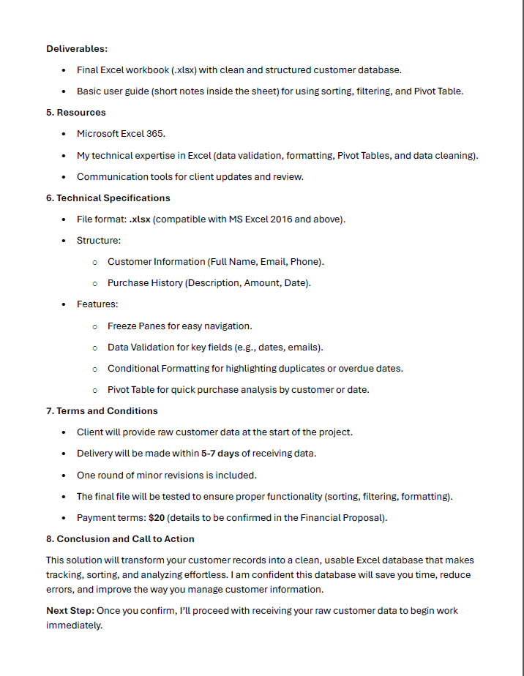
Proposal 1: Technical Proposal

Slide 26
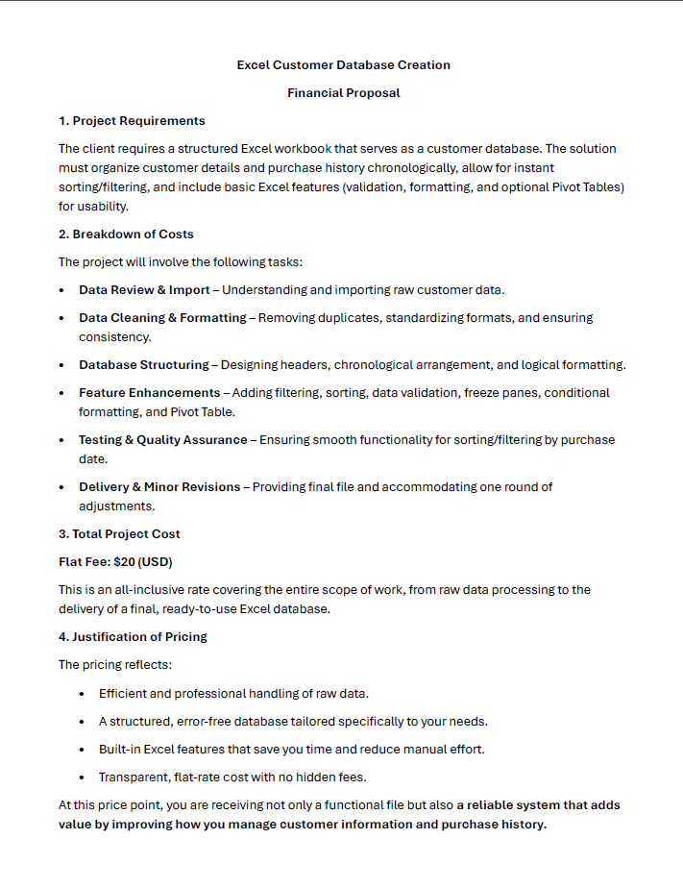
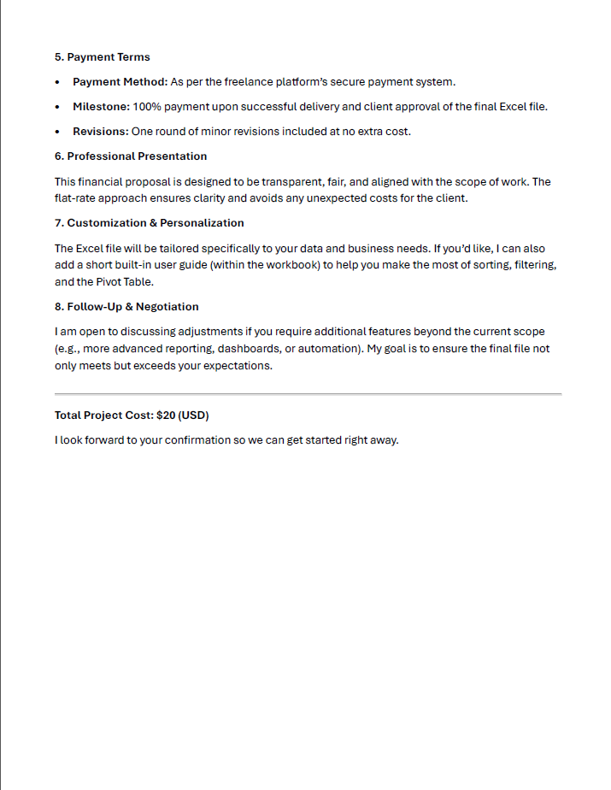
Proposal 1: financial Proposal

Slide 27
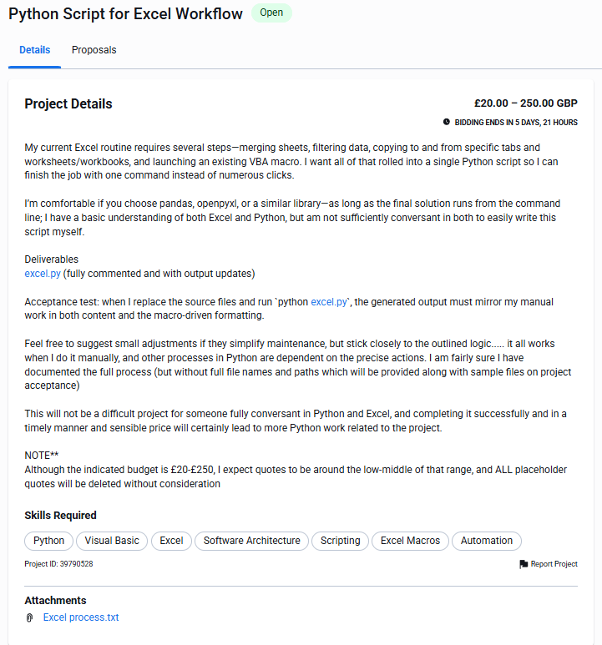
Proposal 2: description

Slide 28
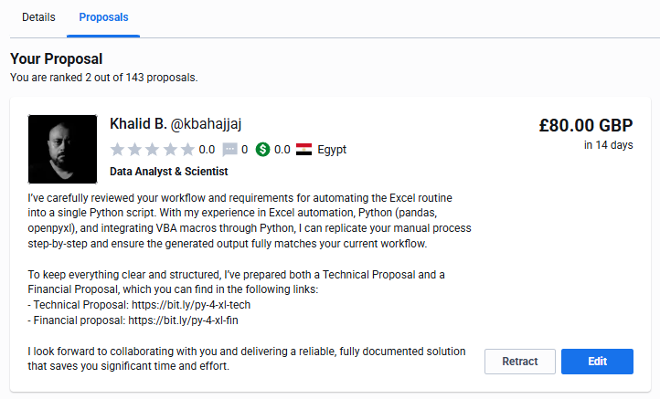
Proposal 2: My Bid

Slide 29
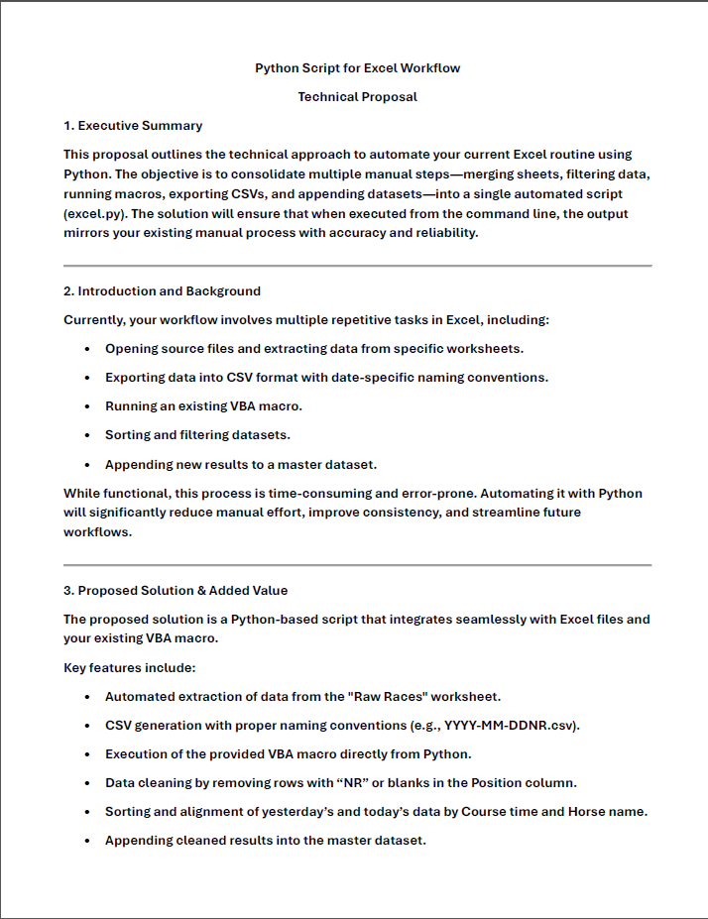
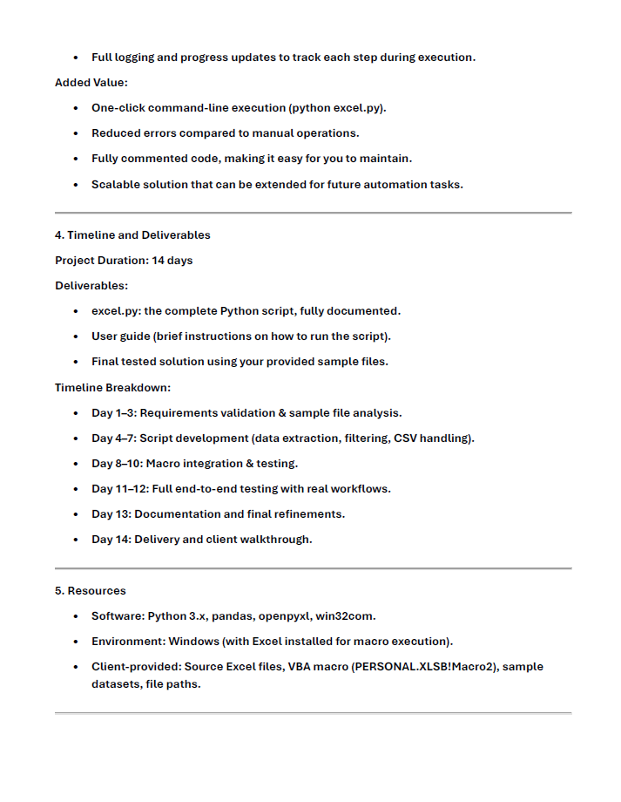
Proposal 2: Technical Proposal

Slide 30
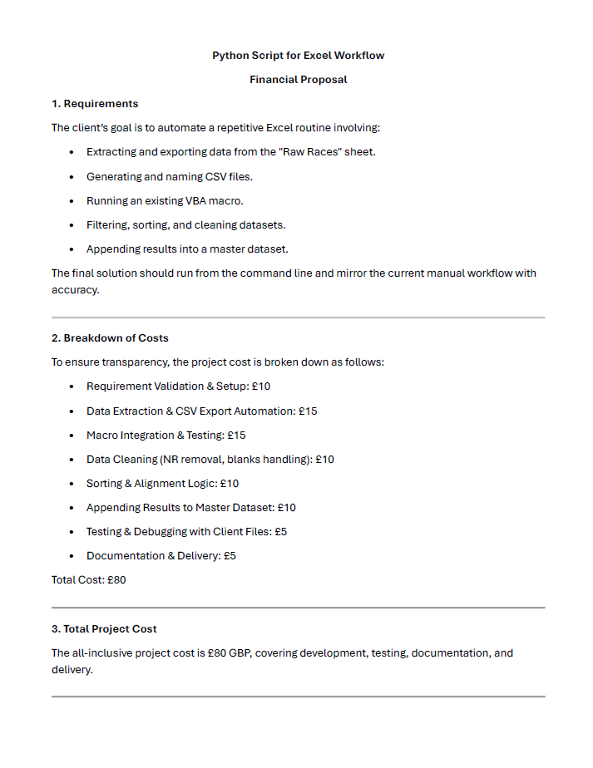
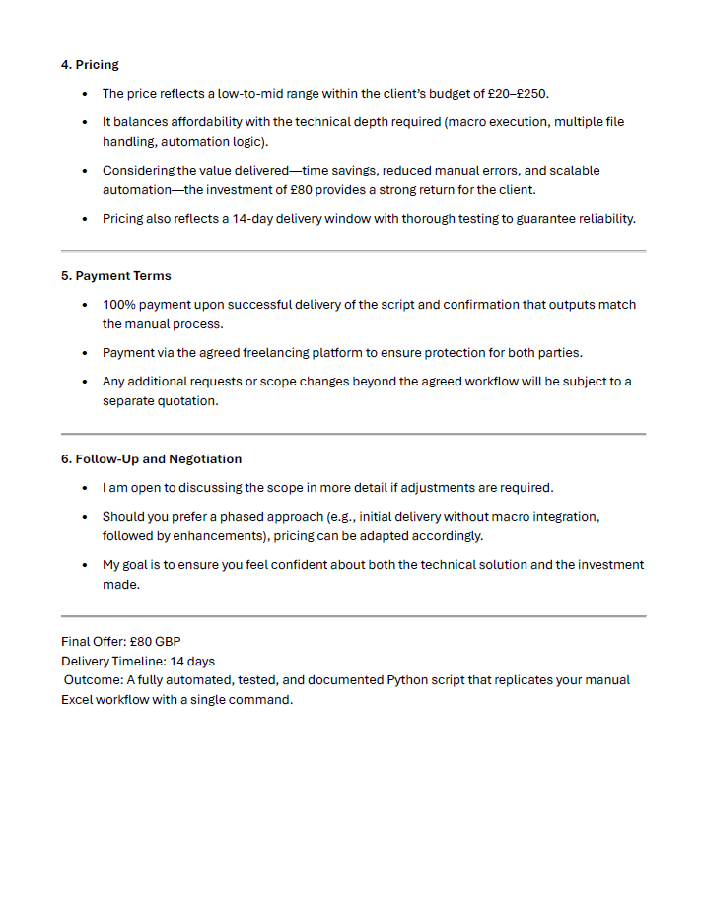
Proposal 2: financial Proposal

Slide 31
Payment Method

Slide 32
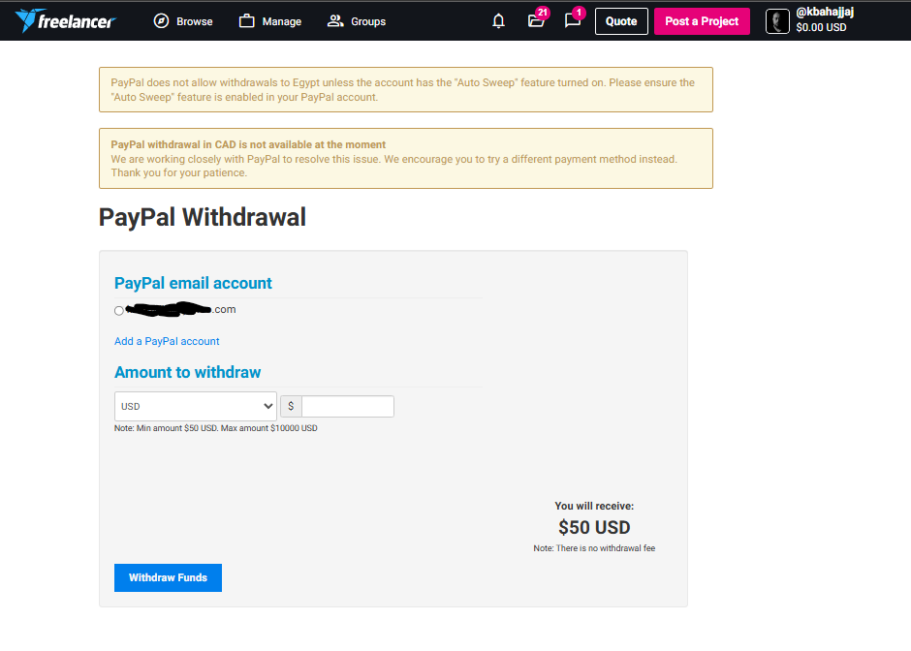
Freelancer

Slide 33
Challenges & Solutions
When submitting my first service on Khamsat.com, they refused it and informed me of some modifications. I waited one day, then came back to do edit the service and found it to be vanished.
I contacted the platform’s customer service. They replied within a couple of hours with the right location to find my service refused service which I then modified and submitted.

Slide 34
THANK YOU
Khalid Salim

